Slide 1

Team Name : Uchiha
Team Leader Name : Shaik Mohammad Asrar Ahammad
Problem Statement : Clinical Notes Summarization Assistant

Slide 2
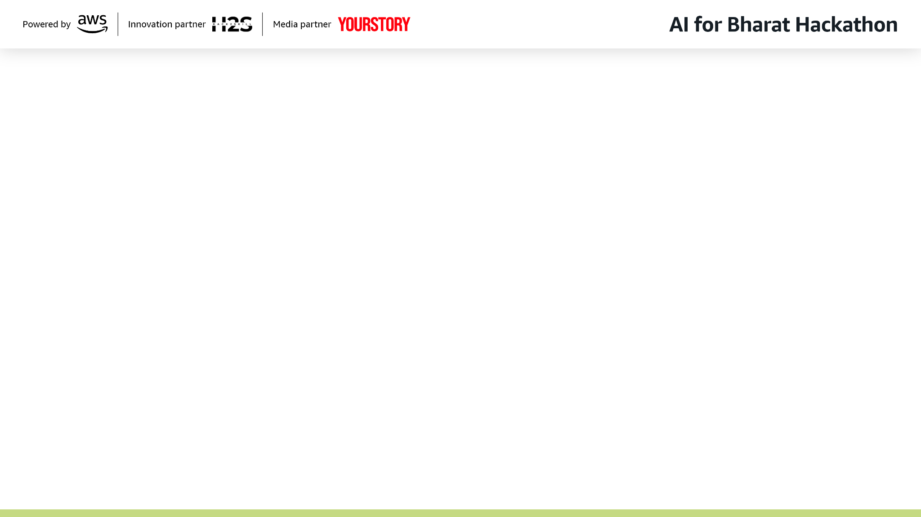
Brief about the Idea: Clinical Summarization Assistant
Summarizes long clinical notes into concise, structured outputs for handoffs and rounds.
Reduces clinician cognitive load and review time using synthetic/public medical data.
Enforces responsible AI: no diagnosis, no treatment, factual fidelity, traceability, uncertainty.
Uses AWS Bedrock, Lambda, API Gateway, and S3 for scalable workflow automation.

Slide 3
How different is it from existing ideas?
Focuses on workflow-grade clinical handoffs vs. generic medical summarization tools.
Enforces strict safety constraints (no diagnosis/treatment), aligned with real hospital responsibility boundaries.
Produces structured summaries with required clinical sections, not just free-text abstraction.
Adds red-flag detection, uncertainty handling, and traceability to source information.

Slide 4
How will it solve the problem?
Converts long free-text notes into actionable summaries optimized for rounds and handoffs.
Reduces cognitive load and documentation review time for clinicians under time pressure.
Improves information transfer and situational awareness across multidisciplinary care teams.
Enables reliable, repeatable, and auditable summaries using synthetic/public datasets.

Slide 5
USP of the Clinical Summarization Assistant (Unique Value Proposition)
Purpose-built for clinical workflow automation, not patient-facing advice or diagnostics.
Responsible-by-design: includes safety filters, compliance constraints, and ambiguity preservation.
Structured outputs allow integration with EHRs, research tools, and downstream automation.
Flexible AWS architecture (Bedrock + Lambda + S3 + optional Kendra) enables scalable deployment.

Slide 6
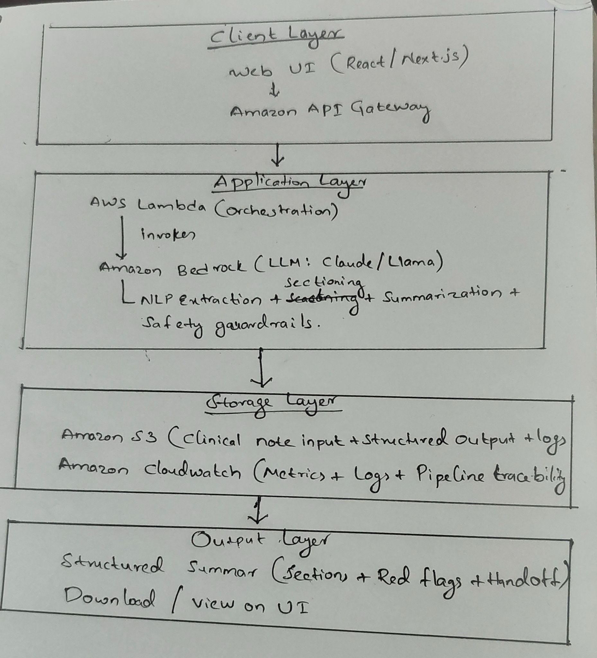
List of features offered by the Clinical Summarization Assistant
Converts long clinical notes into structured, handoff summaries.
Highlights red flags, pending actions, and uncertainties for situational awareness.
Enforces safety constraints: no diagnosis/treatment, source traceability.
Scales via AWS (Bedrock + Lambda + S3) with logging and audit capabilities.

Slide 7
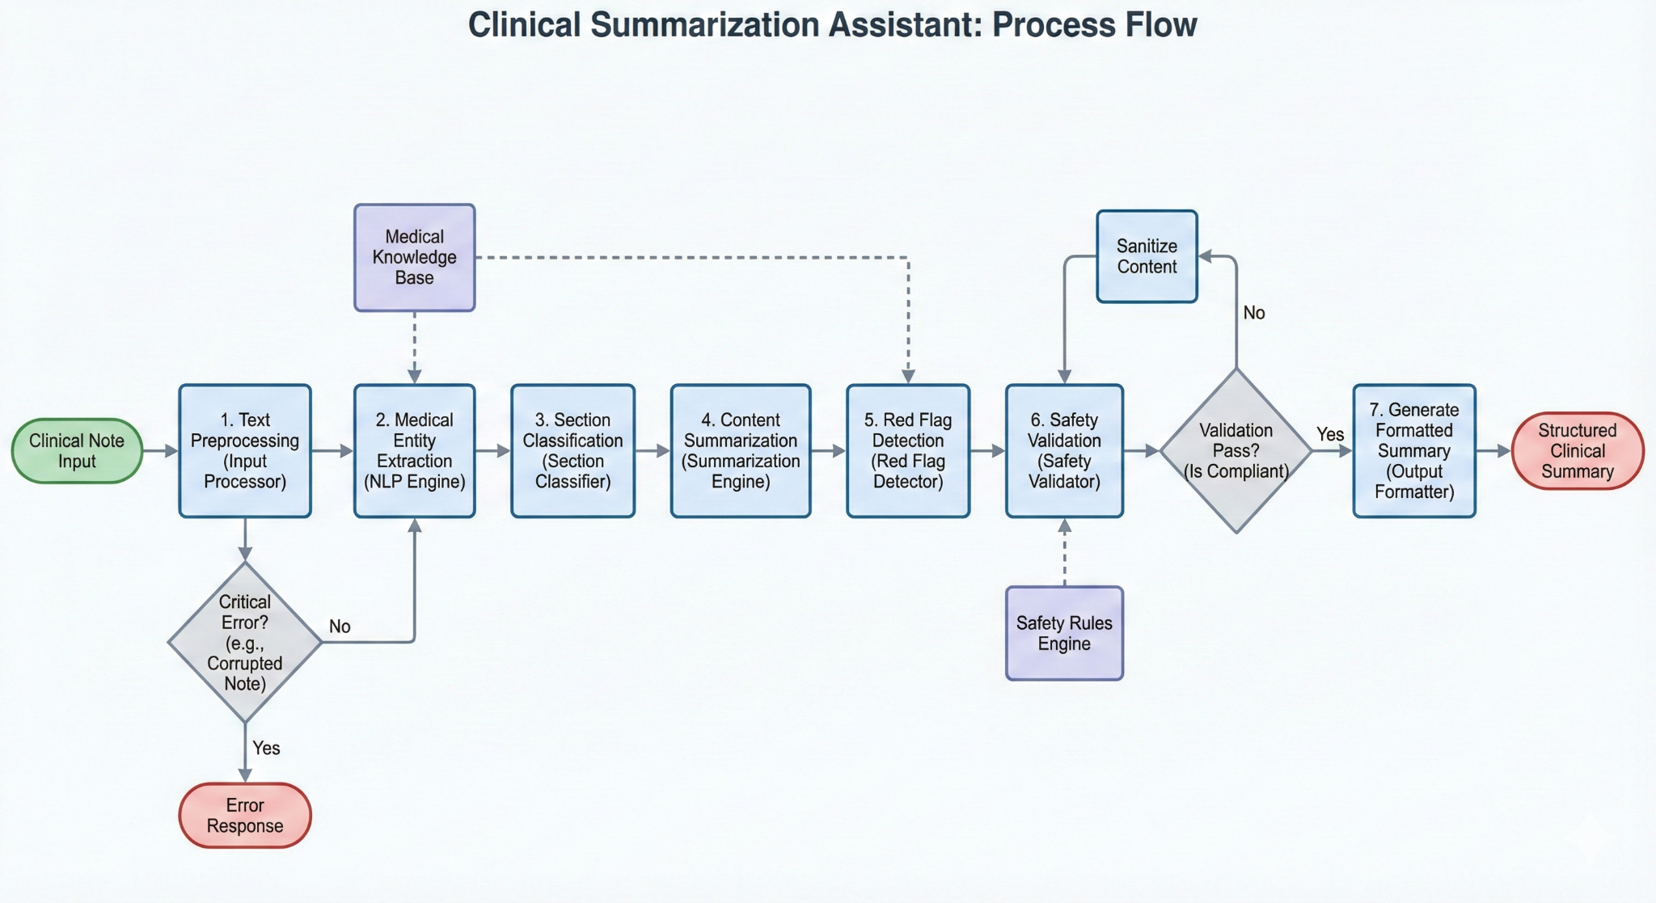
Process flow diagram of Clinical Summarization Assistant

Slide 8
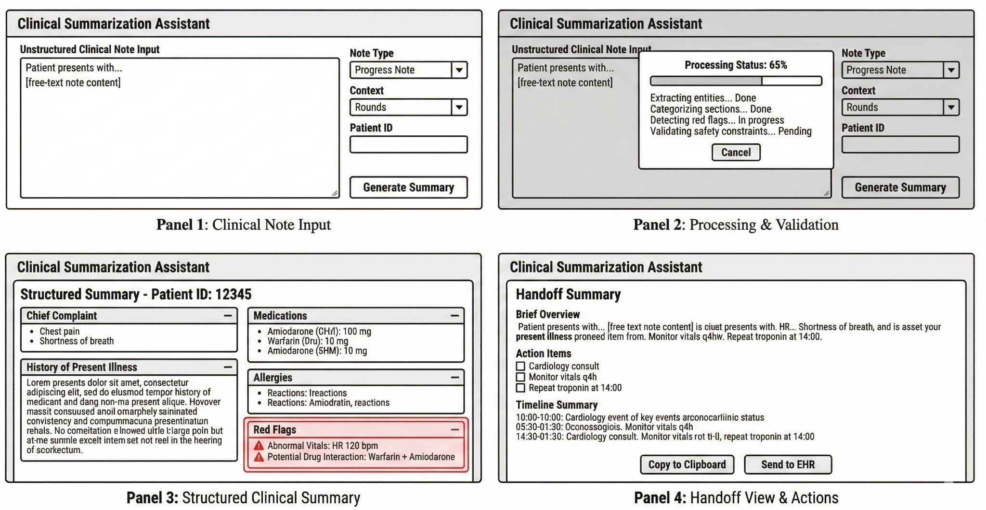
Wireframes of Clinical Summarization Assistant

Slide 9
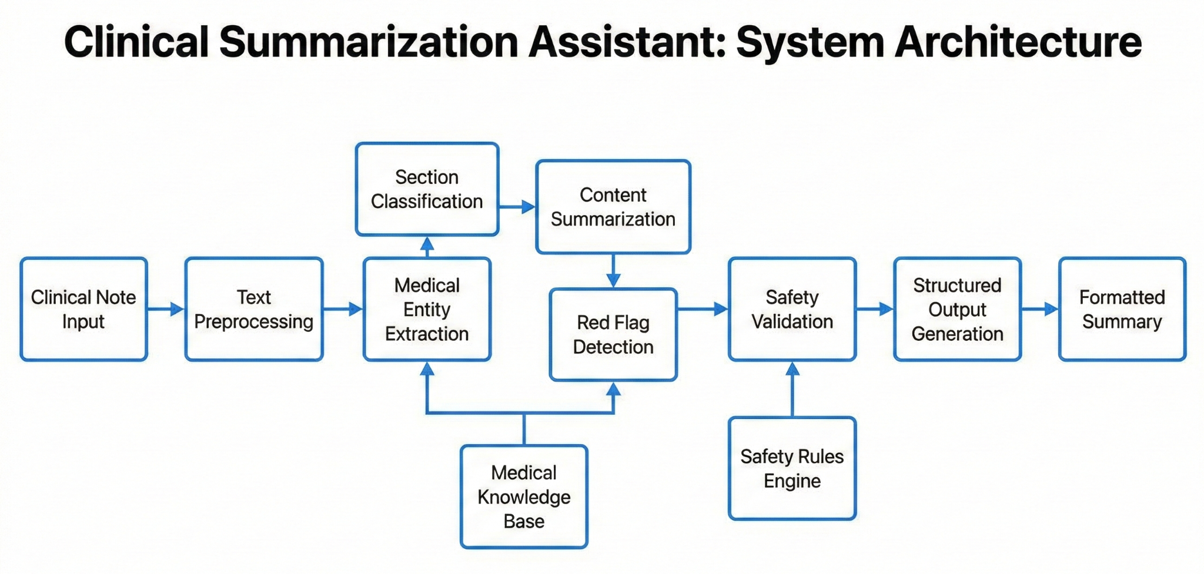
Architecture diagram:

Slide 10
Technologies to be used in the solution:
AI / NLP
Amazon Bedrock (Claude / Llama) for summarization
Optional retrieval: Amazon Kendra / OpenSearch
Backend & Orchestration
AWS Lambda for pipeline orchestration
Amazon API Gateway for service interface
Storage & Observability
Amazon S3 for input/output storage
Amazon CloudWatch for logging, auditing, and monitoring

Slide 11
Technologies to be used in the solution:
Frontend
React / Next.js for structured clinical summary UI
Data & Medical Context
Synthetic/Public clinical notes (e.g., MIMIC/i2b2)
Optional ontologies: SNOMED CT / ICD-10 / RxNorm
Security & Compliance (Optional Enhancements)
AWS IAM for secure access control
AWS Amplify for deployment and scaling (optional)

Slide 12
